Slide 1




Demystifying AWS Certifications: A Beginner's Guide
Justin Wheeler

Slide 2
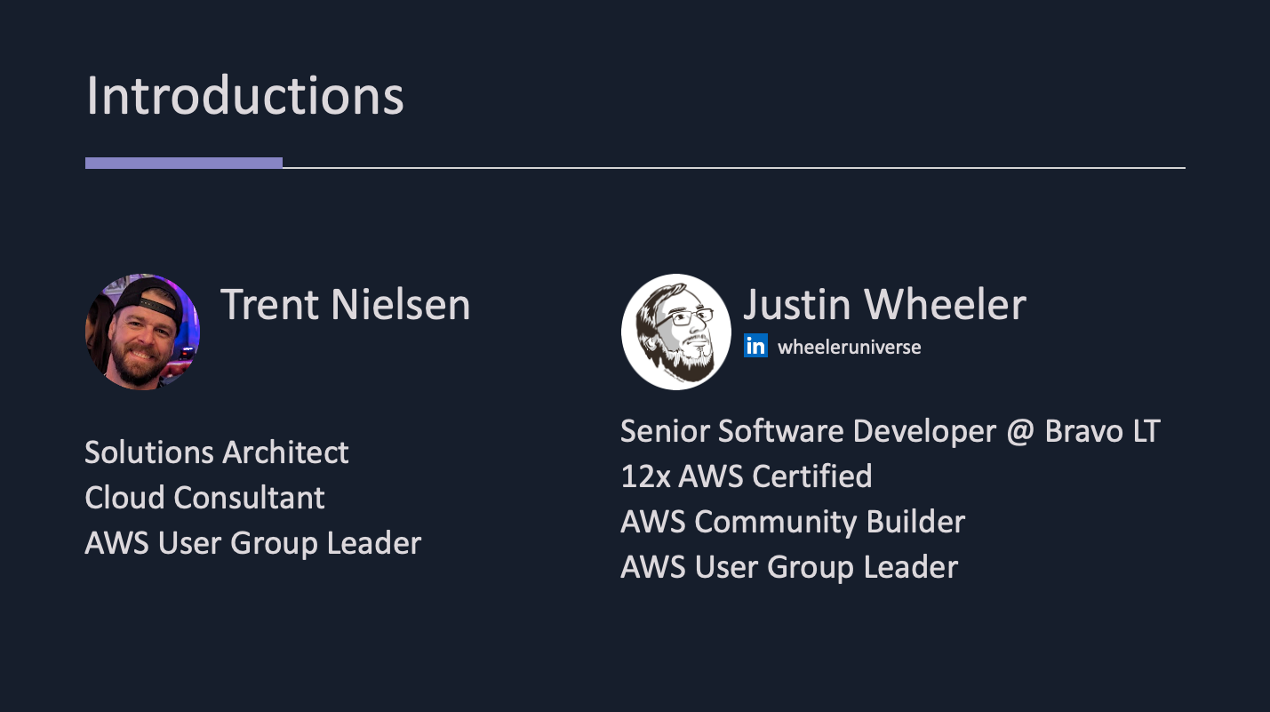
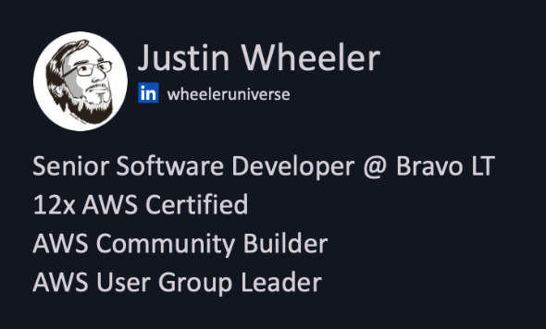
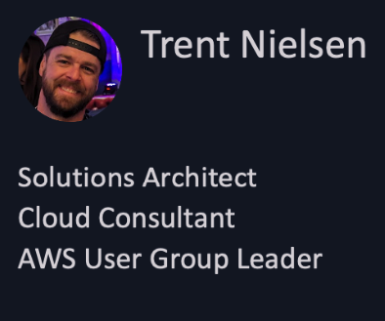


Slide 3
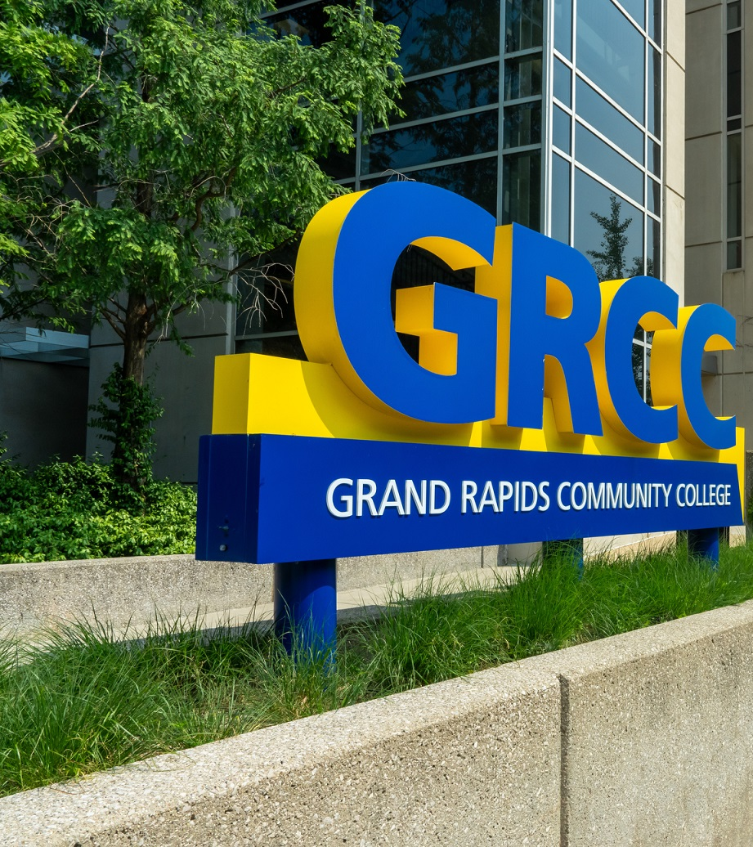

Thank you GRCC! 💞

Slide 4
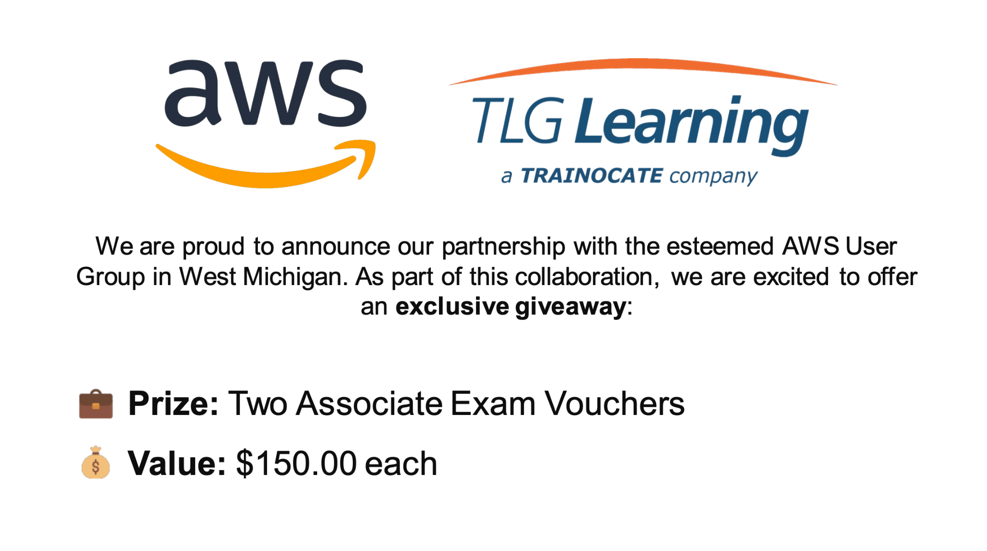






Slide 5
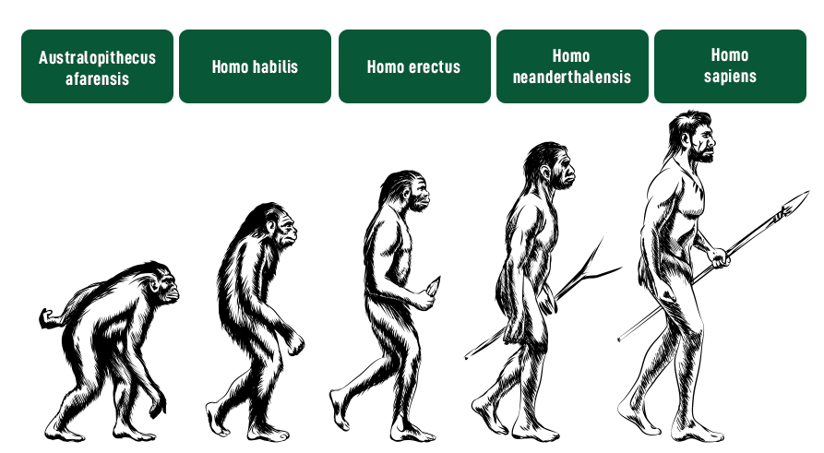
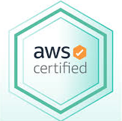
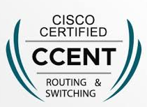


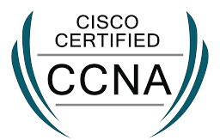
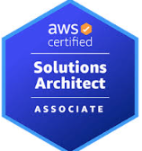





2010
2012
2014
2019
2023
Notes:
Talking Points:
Formally trained in networking, never tested or finished associates
Worked at ISP in non technical role, but joined with hopes of advancing
Discuss how the CCNA helped you land your first job and made you stand out for an interview for tier 1 business support

Slide 6



Expanding My Skillset
Notes:
When I got my first job with limited permissions I was thrilled, but I was disappointed shortly after onboarding. I wasn’t allowed to do much of anything. No trust existsed.
Talk about how continuous certification study helped you transition into voice provisioning and then circuit deployment over 2 years because of demonstrated self study and working on my next cert with my peers.
Studying my CCNP helped me further my knowledge to prepare me for my first engineering role.
I also resumed school to finish out my associates degree

Slide 7



Transitioning Roles and Titles
Notes:
Finished my associates degree
Obtained CCNP Route & Switch
Transitioned to Senior Network Engineer role

Slide 8
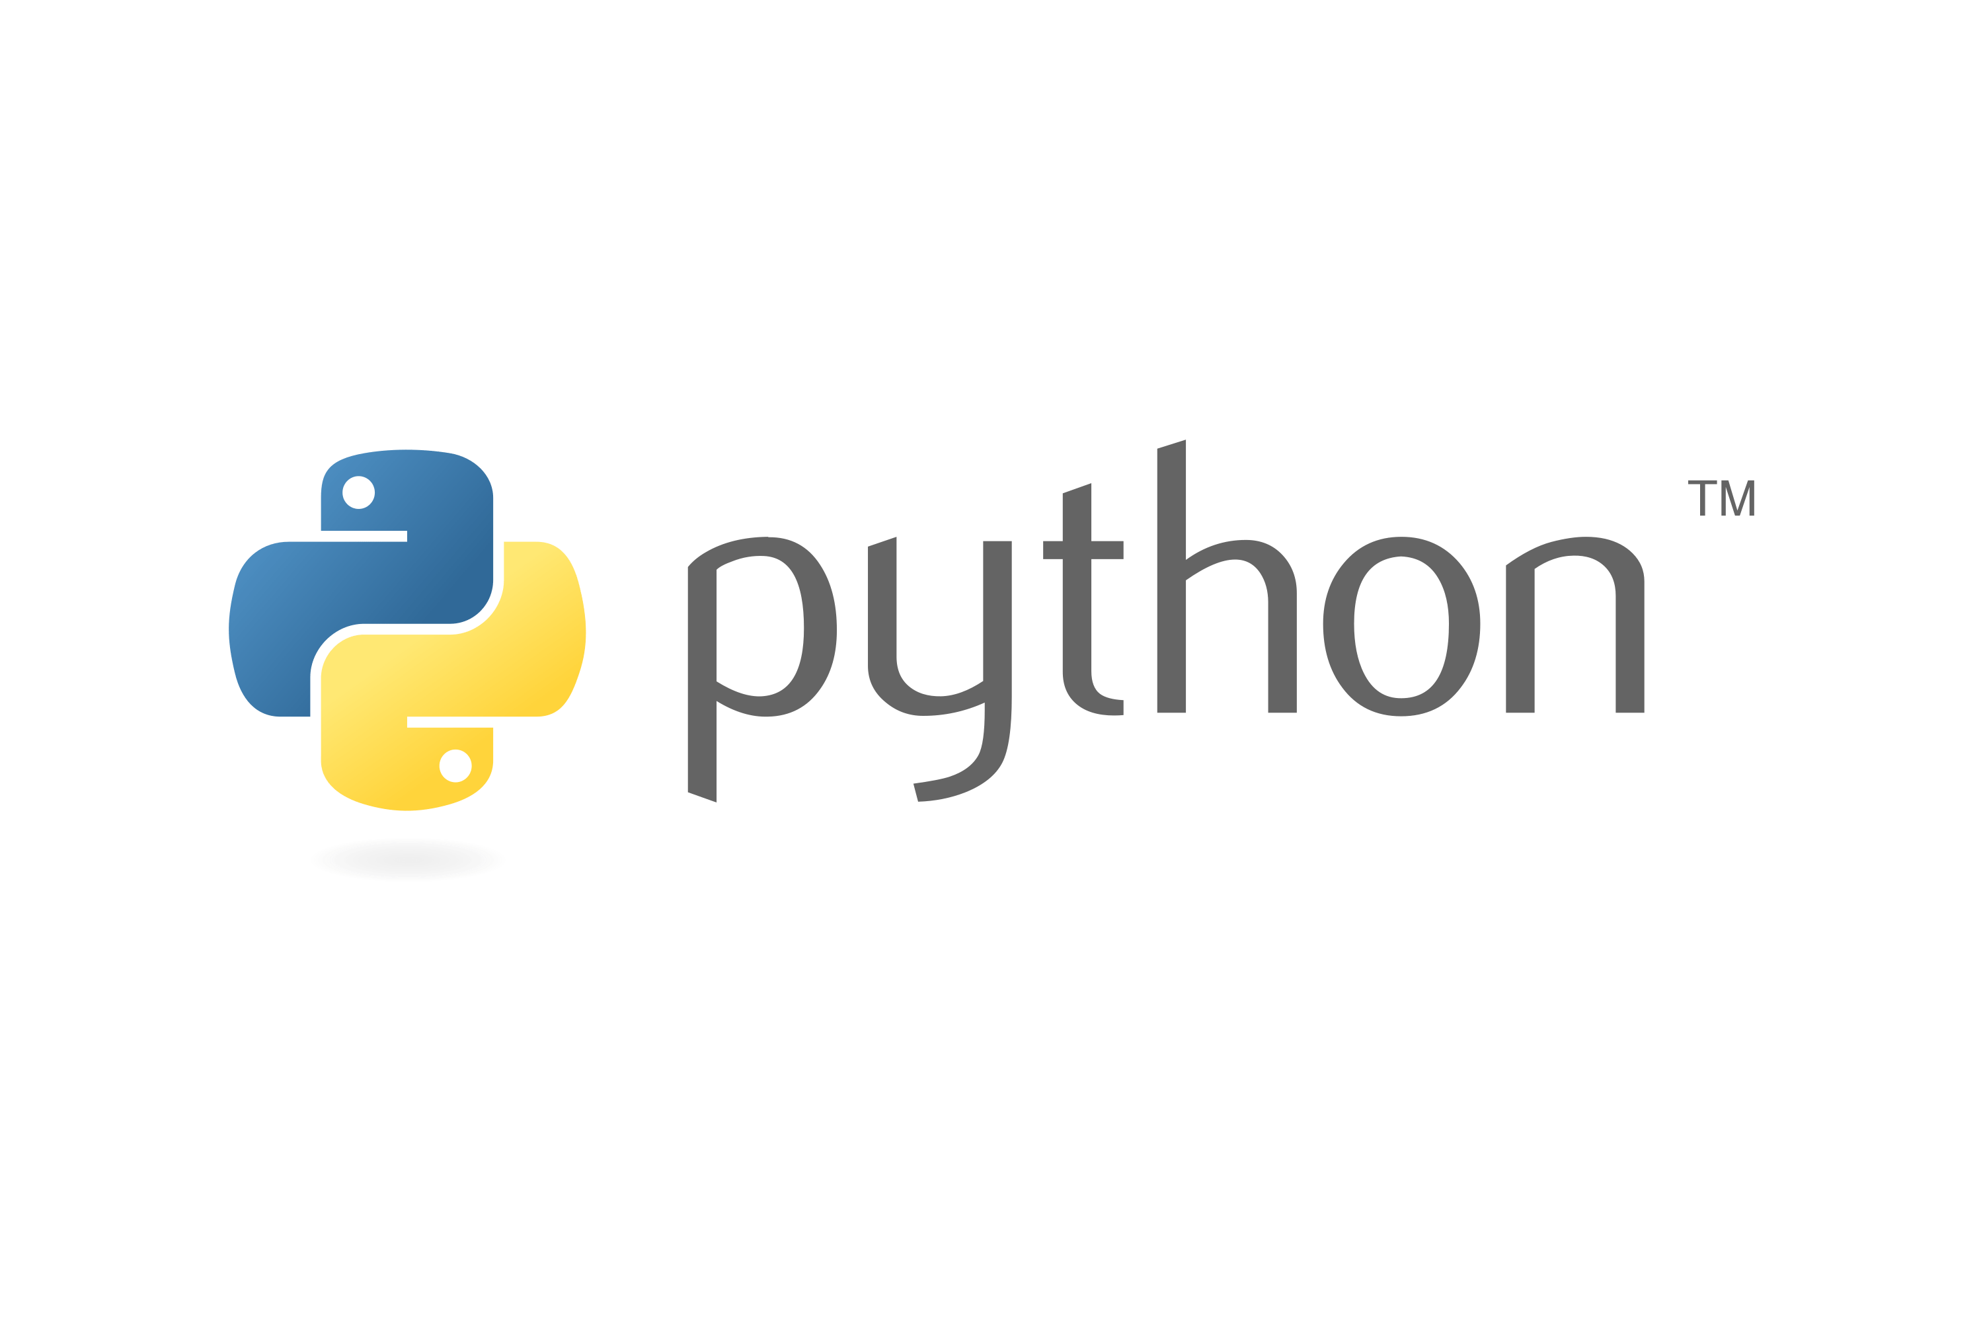


Pivoting to AWS
Notes:
Finished my associates degree
Obtained CCNP Route & Switch
Transitioned to Senior Network Engineer role

Slide 9
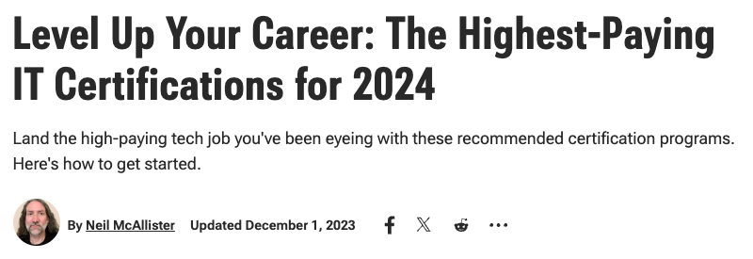
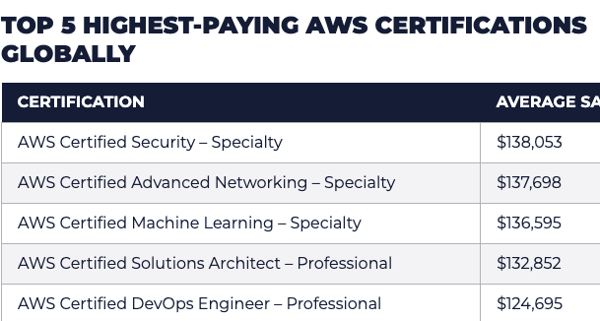
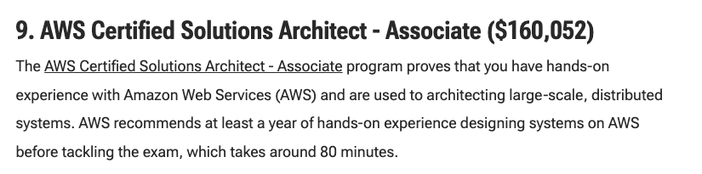
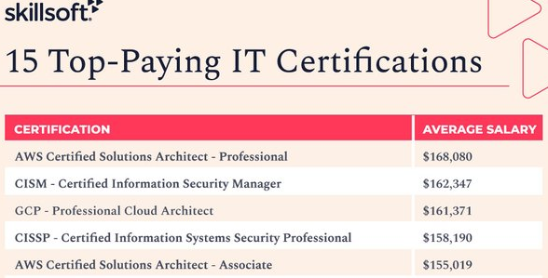
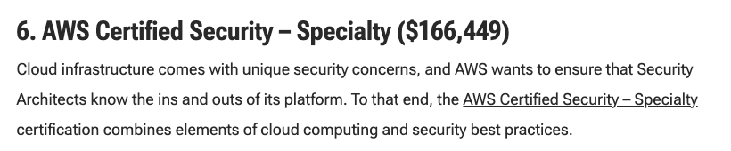
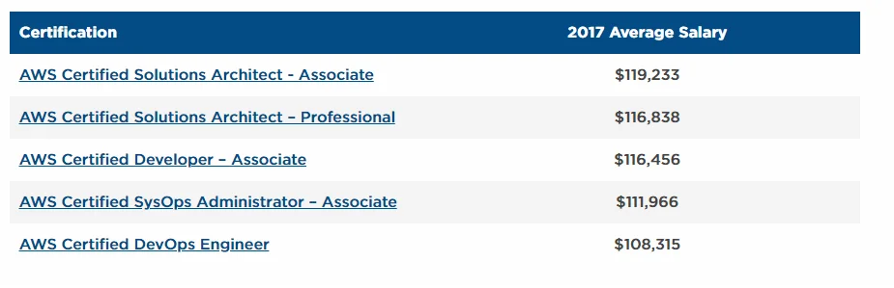

Slide 10
Certifications do NOT guarantee salary

Slide 11

Communication
DevOps
Networking
Problem
Solving
AWS
Scripting
Adaptability
Operating Systems
Security

Slide 12
If not for salary, then why?
Career Progression
Career Opportunities
Career Satisfaction
Continuous Learning
Employer Mandate
Knowledge
Practical Skills
Problem Solving Skills
Reputation
Unknown Unknowns
Validation

Slide 13
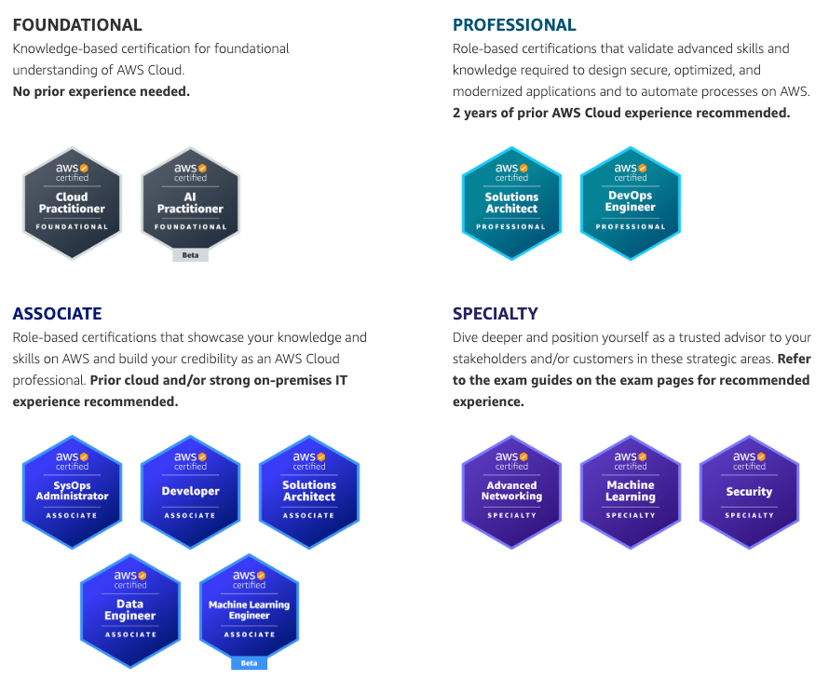
What is a beta exam?
50% discount
Includes more total questions
Includes more scored questions
May include unclear questions
Less training material

Slide 14

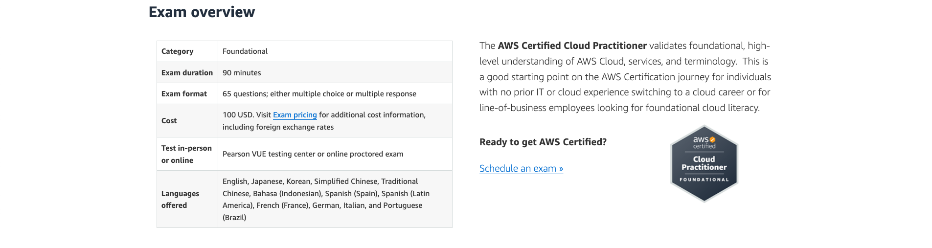

Slide 15

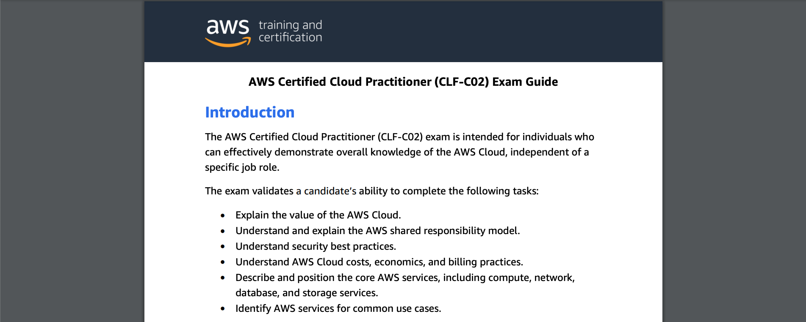

Slide 16

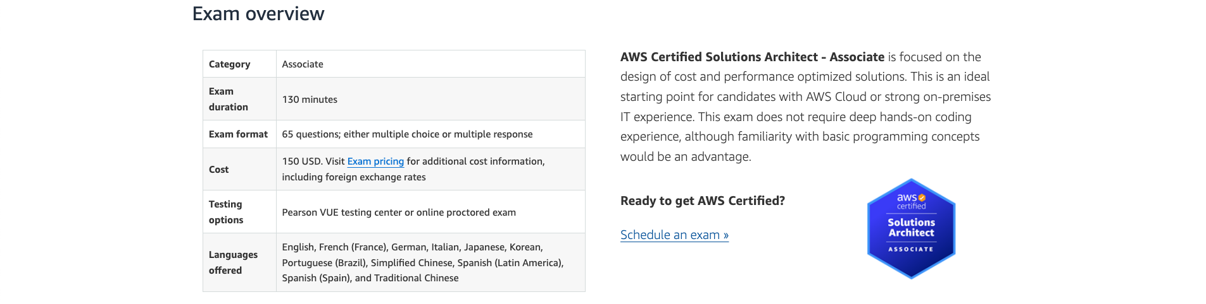

Slide 17

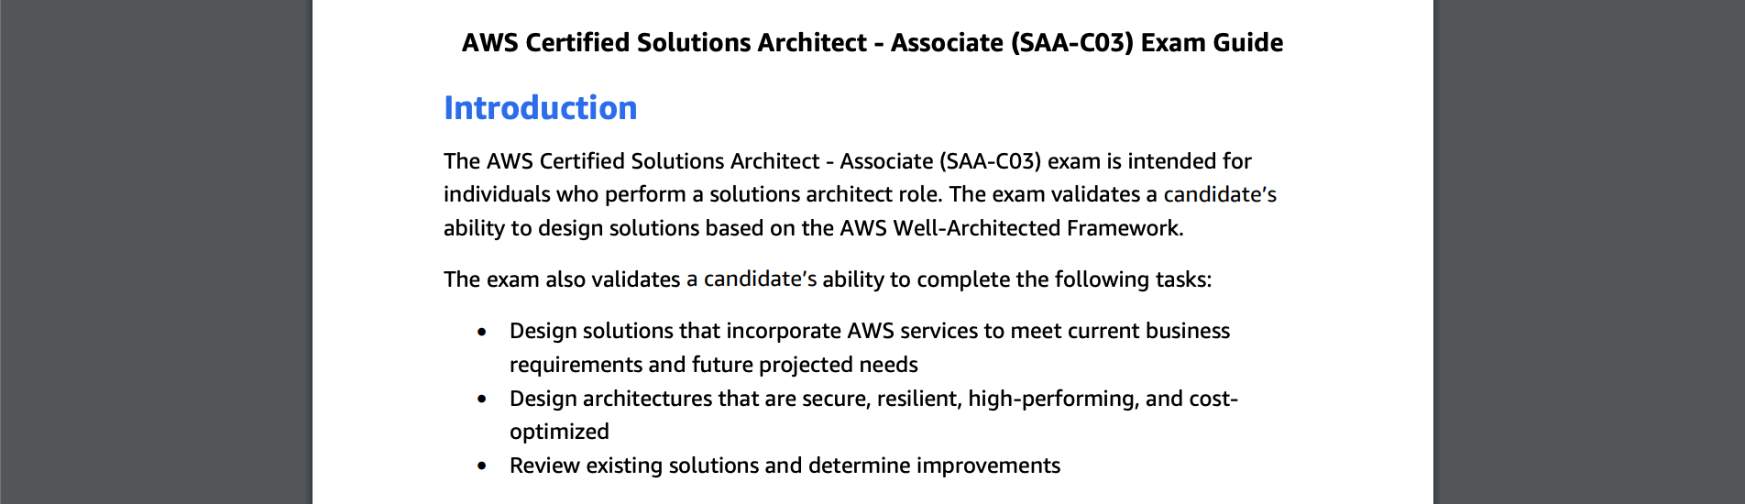

Slide 18
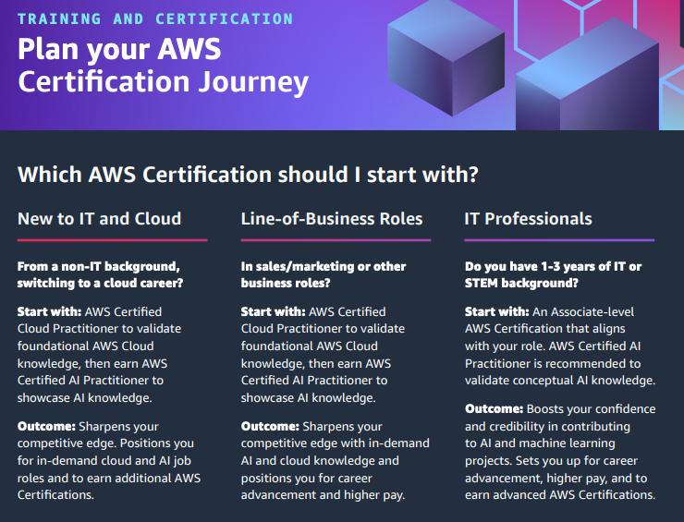


Slide 19
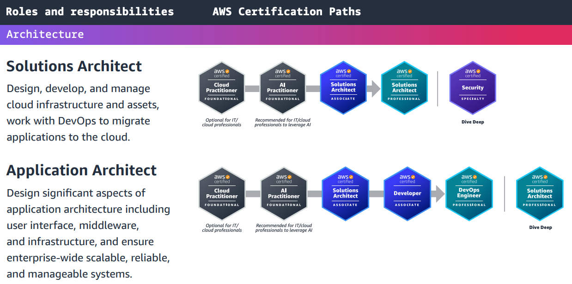

Slide 20
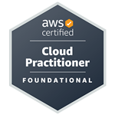
Solutions Architect | Application Architect | Cloud Data Engineer
Software Development Engineer | Systems Administrator | Cloud Engineer
Test Engineer | Cloud DevOps Engineer | DevSecOps Engineer
Cloud Security Engineer | Cloud Security Architect | Network Engineer
Prompt Engineer | Machine Learning Engineer | Machine Learning Ops Engineer
Data Scientist

Slide 21
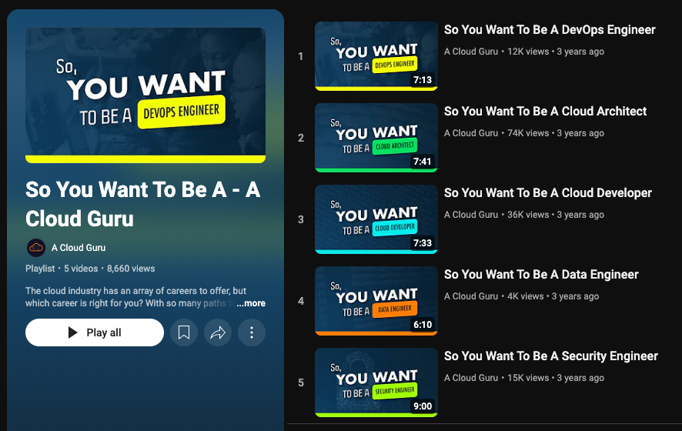

Slide 22
The Impact

Slide 23



Slide 24

Trent Impact Examples
Example 1
Example 2

Slide 25
Trent Impact Examples
Example 1
Example 2

Slide 26

Justin Wheeler’s Journey

Slide 27
Justin Wheeler’s Career Impact
Journey

Slide 28
AWS Training

Slide 29
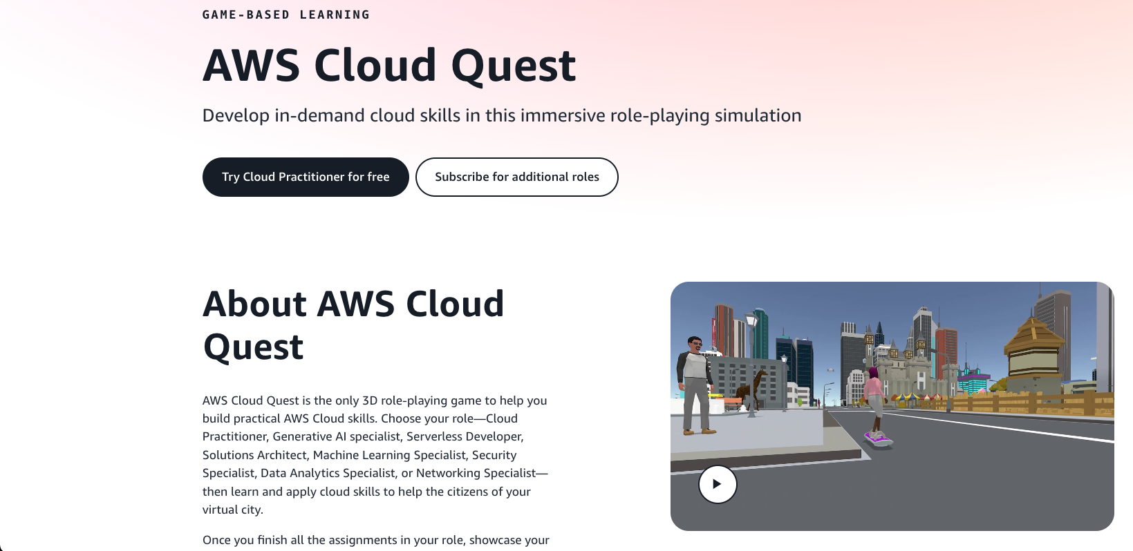

Slide 30
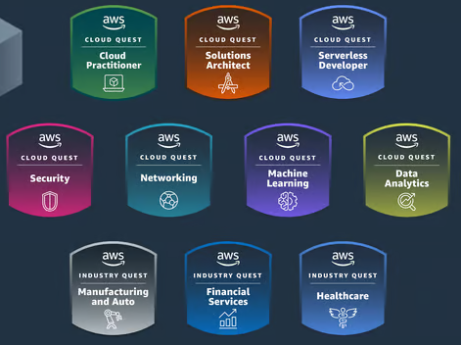
AWS Cloud Quest Roles

Slide 31
AWS Educate

Slide 32
AWS re/Start

Slide 33
AWS Skill Builder

Slide 34
3rd Party Training

Slide 35
abc

Slide 36
Stuffs
Why certifications?
Skill Builder
Benefits
Costs (Money and Time)
Certification Changes in 2024 (retiring exams, training and certification team layoffs)
AWS Partner Program
Exam Format (Multiple Choice, Scenario, Labs, etc.)
Exam Guide and Sample Questions
How they helped in our careers
3rd party training (ACG, Pluralsight, Cloud Academy, etc.)

Slide 37


Discord
Come hang out!

